Slide 1
Design Patterns
Some Patterns Overview
Dec 2016, Wesley

Slide 2
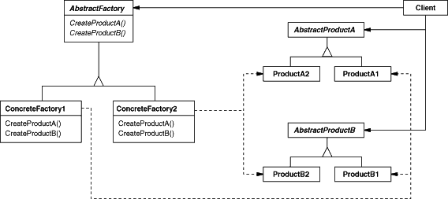
Abstract Factory
Abstract Factory pattern provides an interface for creating families of related or dependent objects without specifying their concrete classes.

Slide 3
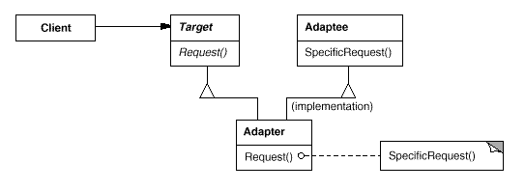
Adaptor
Adapter pattern converts the interface of a class into another interface clients expect. Adapter lets classes work together that couldn't otherwise because of incompatible interfaces.
The pre-condiction is that do not change the existing interface/class, but leverage (inherit/composite) an existing object to implement a new interface.

Slide 4
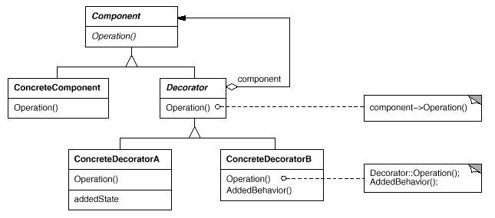
Decorator
Decorator attaches additional responsibilities to an object dynamically. Decorators provide a flexible alternative to subclassing for extending functionality.
The pre-condiction is that existing interface should not be changed, and it's required to supplement functions to existing implementations.

Slide 5
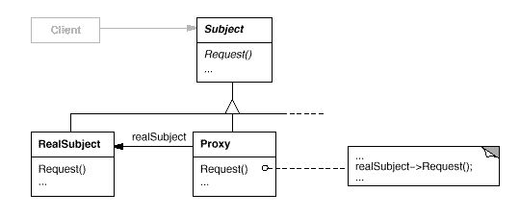
Proxy
Proxy pattern provides a surrogate or placeholder for another object to control access to it.

Slide 6
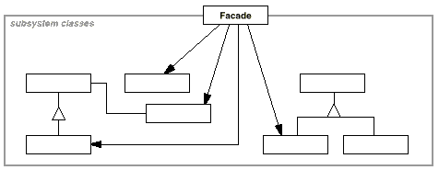
Facade
Provide a unified interface to a set of interfaces in a subsystem. Facade defines a higher-level interface that makes the subsystem easier to use.
The pre-condiction is that not changing the existing several intefaces, but build a new one and consolidate/simplify the interface to caller.

Slide 7
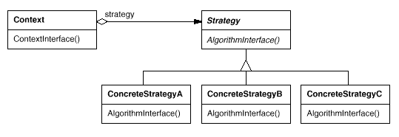
Strategy
Strategy define a family of algorithms, encapsulate each one, and make them interchangeable. Strategy lets the algorithm vary independently from clients that use it.

Slide 8
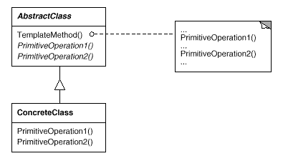
Template Method
Template Method Pattern defines the skeleton of an algorithm in an operation, deferring some steps to subclasses. Template Method lets subclasses redefine certain steps of an algorithm without changing the algorithm's structure.

